Slide 1
Level 2
Until now, the robber could catch you at any time when you were outside of the safe square collecting tokens.
From now on, you will be able to expose the robber – and you will get a bonus if you expose him whilst he is awake.
In order to expose the robber, you have to press the up-arrow key exactly when you think that he is awake.
If you are successful, you will win a bonus. If the robber is not awake when you press the key, you will get nothing.
Notes:
instruction_messageLevelTwo

Slide 2

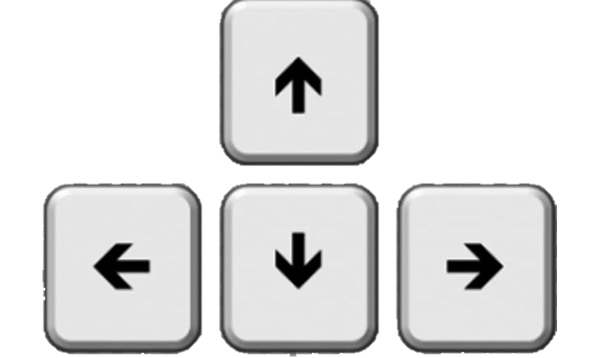
Hence, from now, there are 2 possible game modes.
Collect tokens!
In this game mode, you can see a gray token under the grid. These rounds are the same as in level 1.
Notes:
instruction_messageLevelTwo

Slide 3

2. Catch the robber!
In this game mode, you see a gray robber under the grid. During a round, one token will appear left or right. However, you cannot collect it! The left and right arrow keys are inactive. You can only press the up arrow key to catch the robber.
Notes:
instruction_messageLevelTwo

Slide 4


If the robber is sleeping when you press the key, he turns black and the game proceeds.
If the robber is awake when you press the key, he turns red. This means that you caught him. The round is over instantly, and you can win extra money.
Notes:
instruction_messageLevelTwo

Slide 5
In each round, you can try to expose the robber only 1 time.
The round is over when you expose the robber or when the token has appeared. If you try to catch the robber without success, the up arrow key becomes inactive.
At the end of the experiment, one "Catch the robber" round gets selected randomly. If you managed to expose the robber in this round, you will win an extra 2.5$ on top of the earnings from the selected "Collect tokens" round.
Keep in mind to try to expose the robber exactly when you think he is awake. Be aware that you do not see in advance whether the robber is awake or not.
Notes:
instruction_messageLevelTwo

Slide 6
You will now be subject to a short comprehension test.
Click next to start.
Notes:
instruction_messageLevelTwo

