Slide 1
Welcome to the Approach Avoidance Game
Press next to start the game.

Slide 2
Level 1
You will be playing an easy computer game.
Your task is to collect as many tokens as possible, and to avoid losing them.
Please read the following instructions carefully.
Notes:
instruction_messageAlternateVersionLevelOne

Slide 3

In each round, you will see a playing board with 4 fields.
You are the green triangle at the bottom.
In front of you sits a sleeping "robber".
You are in a dark gray "safe square" which the robber cannot access.
Notes:
instruction_messageAlternateVersionLevelOne

Slide 4
There are 3 different types of robbers in this game.
They are all gray - but the color of the frame is different : yellow, purple or cyan-blue (like here).
These robbers are differently dangerous. It is important that you learn how the robbers differ from each other - and that you adapt your strategy to it.
Notes:
instruction_messageAlternateVersionLevelOne

Slide 5

Below the playing board you can see how many tokens you could lose each round.
In the following picture, for example, you see a yellow robber from which you could lose two tokens if you get caught.
Notes:
instruction_messageAlternateVersionLevelOne

Slide 6

Here you could lose one token from a purple robber.
Notes:
instruction_messageAlternateVersionLevelOne

Slide 7
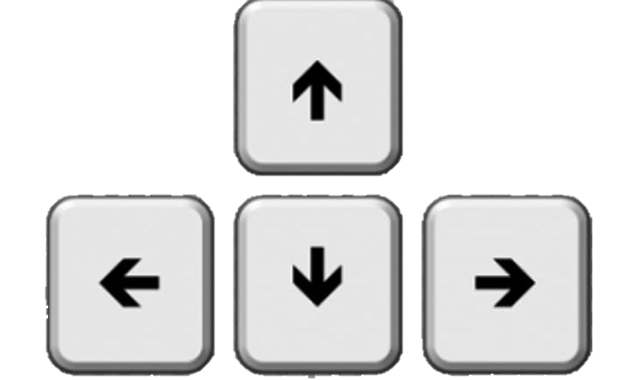
From time to time, yellow tokens pop up in the left or right empty squares.
Each token will disappear after some time.
To collect the token, move to the token’s square and back onto the safe square by pressing the arrow keys of your keyboard (right/left).
You can only move left and right, and cannot reach the field where the robber sleeps.
Notes:
instruction_messageAlternateVersionLevelOne

Slide 8
For example, a yellow token might pop up in the left empty squares.
If you decide to try to collect it, you need to press the left arrow key.
Then to avoid the robber, you need to press the right arrow key to return to the safe place.
Notes:
instruction_messageAlternateVersionLevelOne

Slide 9



In the following picture, you see a round with the yellow robber when a token just appeared.
Once you collected it, it appears on the top part of the playing board like here with a purple robber.
Notes:
instruction_messageAlternateVersionLevelOne

Slide 10

However, the sleeping robber can wake up at any time and attack you if you are outside of the safe square.
If you get caught, the round will end and you will lose the amount of tokens displayed below.
Try to avoid this.
Notes:
instruction_messageAlternateVersionLevelOne

Slide 11
Remember that your task is to collect the token in each round without losing any. If you get caught, you will lose tokens.
With time, you will get a feeling for how fast tokens are appearing and disappearing, and more importantly, a feeling for how often the robber will awake and attack you.
Please keep in mind that you can lose many tokens if you get caught. If you want to prevent that, just stay in the safe square and do not try to catch the new token. It is important that you remember that the robbers are not equally dangerous, so you should adjust your strategy.
By the way, whether you collect a token or not - the next token will not appear any faster or slower. Therefore, you cannot shorten the experiment with your strategy.
Notes:
instruction_messageAlternateVersionLevelOne

Slide 12
At the end of the experiment, 6 rounds will be selected randomly.
For each selected round, you will either receive an extra 2$ for the token won or you will lose 2$ for each token lost. Additionally, you will receive a fixed 10$ participation payment.
Therefore, if you are unlucky and you have lost a lot of tokens in that selected round, you will not receive any extra amount of money.
To prevent that, try to not get caught by the robber.
Notes:
instruction_messageAlternateVersionLevelOne

Slide 13
You will now be subject to a short comprehension test.
Click next to start.
Notes:
instruction_messageAlternateVersionLevelOne

